Slide 1
SAP PRESENTATION
General Ledger

Slide 2
GL Account Posting
.NO 04 -FI-GL-01
TRANSACTION CODE FB50/ F-02
ACCESS PATH SAP Easy Access → Accounting → Financial Accounting→ General Ledger → Document Entry → GL Account Posting
We get “GL Account Postings” Screen
In the above mentioned screen enter the relevant fields viz. Document date, GL
Account number, and amount.
Press Enter
Incorporating the entered fields the system displays the screen as under

Slide 3
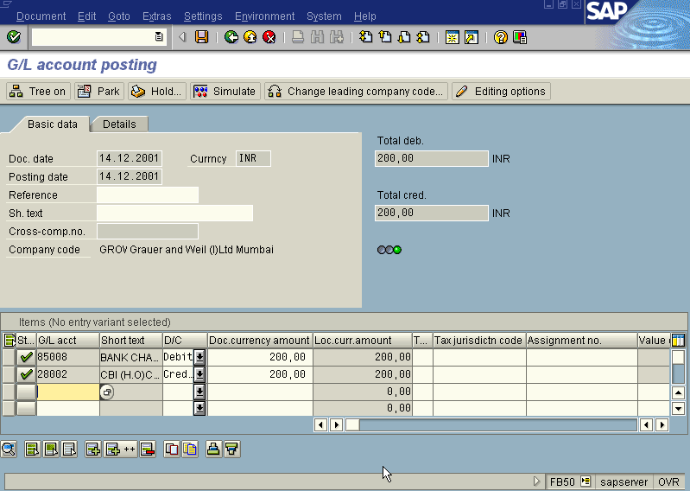
Press Save/ Post
The System displays the message with Document number. Take note of the
document number eg. 100086.

Slide 4
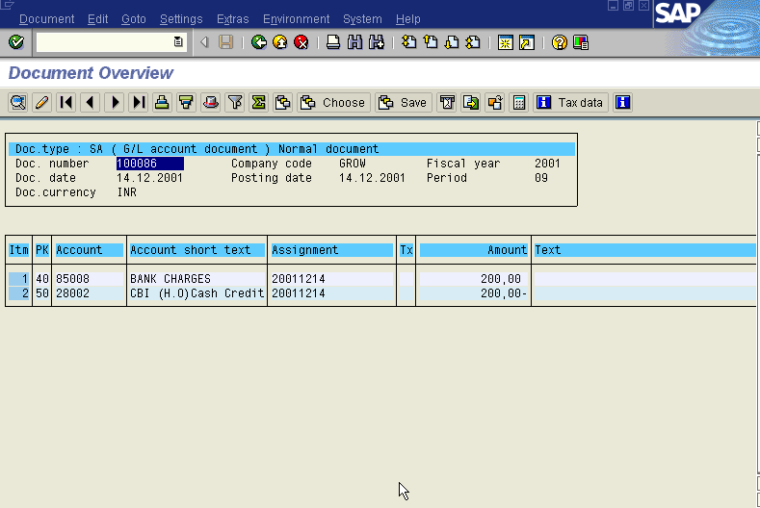
To display the entries passed press FB03 or Go to top of the screen and select
Document → Display. The system displays the overview screen as under

Slide 5
Posting a GL Account with Transaction code F-02
ACCESS PATH SAP Easy Access → Accounting → Financial Accounting→ General Ledger → Document Entry → Other →General Postings
We get “ Enter GL Account Postings – Header Data” Screen
Enter the relevant fields Document Date, Posting Key 40 for GL Debit and 50 for GL
Credit.
We get the screen as under

Slide 6
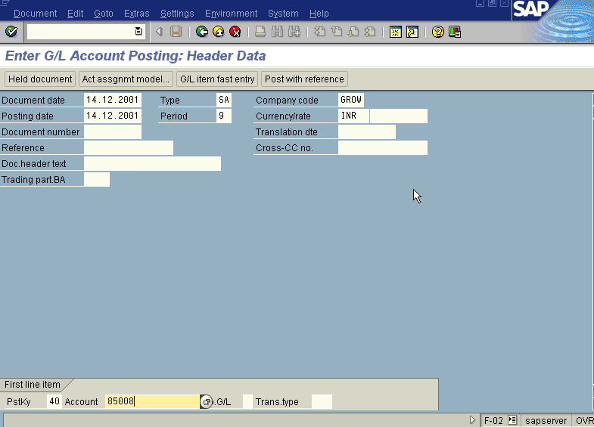
Press Enter

Slide 7
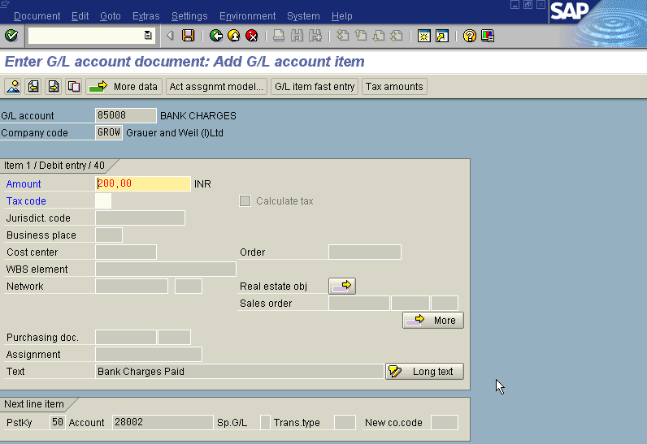
Press Enter

Slide 8
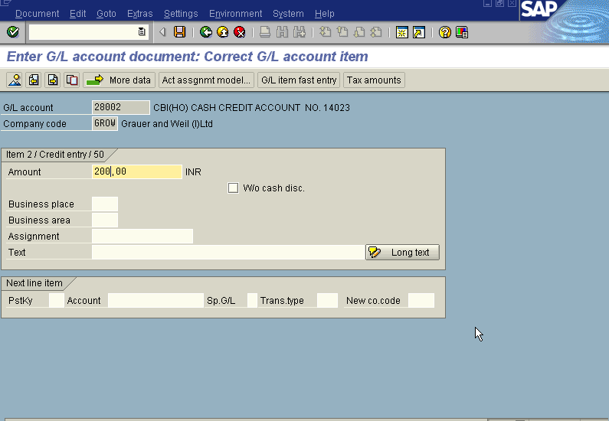
Press post/save
The system displays the message with document number. Take note of the document
Number eg:100087

Slide 9
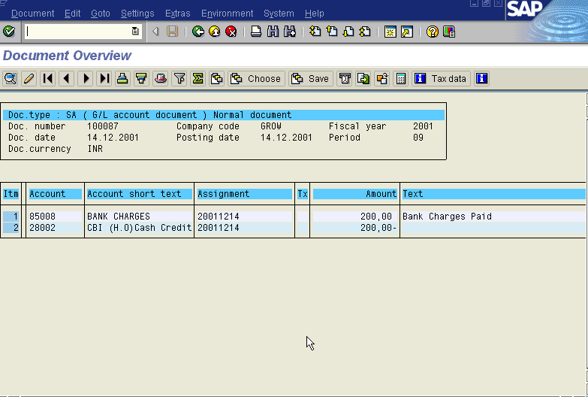
To display the entries passed press FB03 or Go to top of the screen and select
Document → Display. The system displays the overview screen as under

Slide 10
Cash Journal Posting
S. NO 04 -FI-GL-02
TRANSACTION CODE ZFBCJ (This is a Special Transaction code designed as per the requirements of user.)
ACCESS PATH SAP Easy Access → Accounting → Financial Accounting→ General Ledger → Document Entry → Cash Journal Posting
This access path will take you to Tr. Code : FBCJ
(The difference between two transactions FBCJ and ZFBCJ is that FBCJ is the standard transaction code which does not support the Special GL transactions for posting from Cash Journal. The Transaction ZFBCJ enables entry of Special GL Transactions from Cash Journal.)
From this Tr. Code, we get “Cash Journal Postings” Screen In the above-mentioned screen, two options are available - Payments and Receipts.
By default system displays Cash Payment Voucher. When entering Cash Payments, Cash Payments tab has to be selected and similarly for Cash Receipts as well.

Slide 11
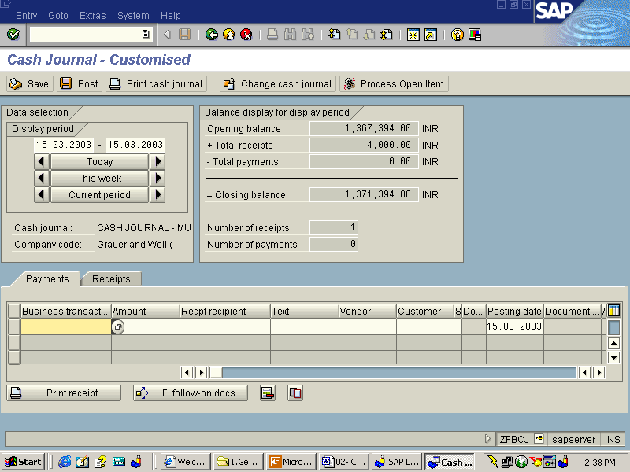

Slide 12
Firstly, basing on the type of payment/receipt, the relevant business transaction has to
be selected. The Business transaction will post to the relevant GL Account.
After selecting the Business Transaction, the amount has to be filled up along with the
Recipient /payee and text.
Another Important field to be filled for all expenses is Cost Center.
In case of cash payments/receipts to/from Customers / Vendors -- the relevant
Business Transaction Customer Posting/Vendor posting has to be selected.
If it is Special GL Transaction, Sp. GL Indicator has also to be selected
To Clear the invoice from cash Journal
Cash Incoming/ outgoing payment from customer/vendor has to be posted first from
cash journal.
Along with Sp. GL Transactions facility, Process Open Items facility is also made
available from Cash Journal
The open item in the customer /vendor account and the payment received/paid
(from/to customer /vendor) from cash journal can be cleared by entering the
customer /Vendor account from Process Open Items Button made available in Cash
journal.
To view the document posted from Cash Journal
Keep the cursor on the appropriate line item and press FI -Follow on Documents
Button.

Slide 13
Park GL/ AR and AP Document
We use 'document parking' if:
Information required to post the invoice document is still missing and you do not want to have to re-enter data already entered.
The balance of the invoice document is not zero
The following updates are to take place:
Log of document changes
Information on the PO history
Data for advance tax returns
Index for duplicate invoice check
Vendor open items
At a later time, you can change, delete, and post park documents, or save them as complete for posting.
S.NO 04 -FI-GL-03
TRANSACTION CODE F- 64/65
ACCESS PATH SAP Easy Access → Accounting → FinancialAccounting→ Accounts Receivable → Document Entry → Park Document

Slide 14
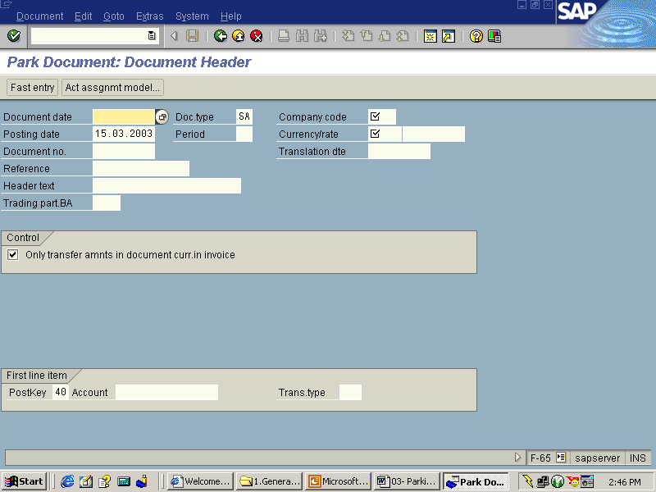

Slide 15
On Screen “ Park Document: Document Header” enter the relevant fields
Document Date Enter the document created date
Document Type “DR” for Customer Invoice( by default), “SA” for General Ledger, “KG” Vendor Credit Memo
Company Code Grow
Posting date Default System Date
Account Key “01” for Customer Invoice, “40” for GL Posting and “21” for Vendor Credit memo
Account Customer Account (10571) / GL Account accordingly to be selected
Press Enter
Amount Enter the amount to be posted
Payment terms Default
Baseline date Payment due date
Account Offsetting Account (eg: 50001 – Domestic Direct Sales)
Press Save/ Park
The system displays the document number and states that the document is parked.
Take a note of that document number eg: 1801212
Note: Parking of the document can be done from relevant GL Posting,
Customer Invoice etc. Screen by clicking on the Post Document Button.

Slide 16
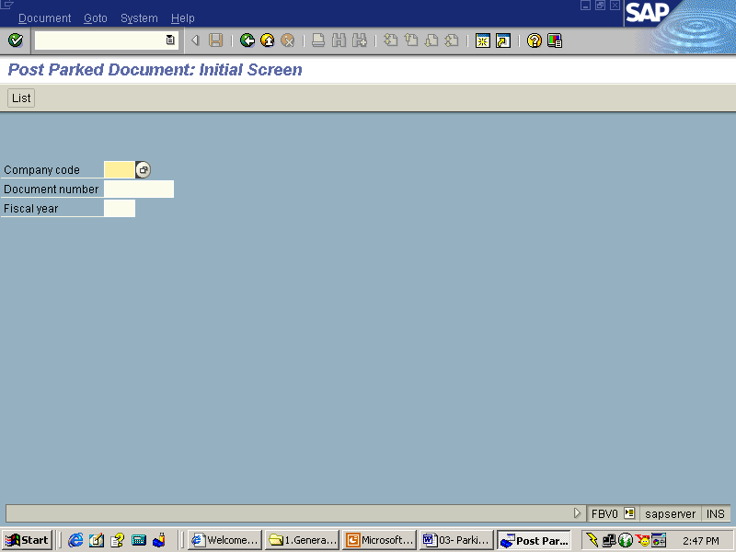
Posting Parked Document
S.NO 04 -FI-GL-04
TRANSACTION CODE FBV0
ACCESS PATH SAP Easy Access → Accounting → Financial Accounting→ General Ledger → Document → Parked Document→ Post/Delete

Slide 17
We get “Post Parked Document – Initial Screen”. Enter the information in the relevant
Fields.
Company Code GROW
Document Number Parked Document Number to be Posted (eg: 1801212)
Fiscal Year 2002
Press Enter
The System displays the Park document Overview screen
Press Save
The system displays a message that the parked document was posted to the
company code

Slide 18
Reversing Document
TRANSACTION CODE FB08
ACCESS PATH SAP Easy Access → Accounting → FinancialAccounting → Accounts Receivable → Document →Reverset → Individual Reversal

Slide 19
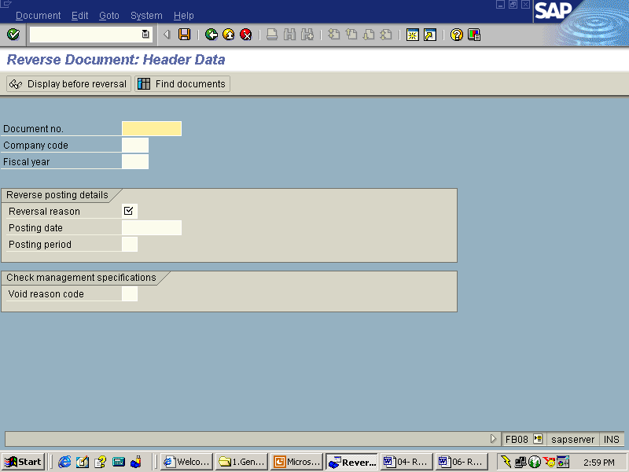

Slide 20
We “Reverse Document – Header Data” screen. Enter the information on the relevant
Fields.
Document Number Document to be reversed (eg: 1801212)
Company Code GROW
Fiscal Year 2001
Reversal Reason- 01 (Reversal in Current Period)
Posting Date- Date on which the posting document is to be reversed
Posting Period- Period of reversal posting
Press Enter
Press Save/ Post Button
The system displays a message with a document number. Take a note of the
document number. eg: 1801213

